Slide 1

Advanced OOP
Mantas Boronilščikovas
mantas.boronilscikovas@swedbank.lt

Slide 2
Agenda
Annotations
Design patterns
OOP Concepts
Immutability
Generics
Functional Interface
Optional
Fancy Java features

Slide 3

Annotations

Slide 4
Annotations
A form of metadata, provide data about a program that is not part of the program itself. Annotations have no direct effect on the operation of the code they annotate.
Annotations have a number of uses, among them:
Information for the compiler — Annotations can be used by the compiler to detect errors or suppress/show warnings.
Compile-time and deployment-time processing — Software tools can process annotation information to generate code, XML files, and so forth.
Runtime processing — Some annotations are available to be examined at runtime.

Slide 5
Annotations
An annotation always starts with the symbol @ followed by the annotation name. The symbol @ indicates to the compiler that this is an annotation.
Some annotations examples:
@Override
@Deprecated
@SuppressWarnings
@Data
@Value
Notes:
@Override – nurodo kad metodas overridina super clases metoda. Compile time metu failintu, jei blogas override, pvz spelling mistake
@Deprecated – naudojama kai norima pazymeti kad metodas yra pasenes ir/arba bus istrintas ateityje, ir kai kas nors ji naudos, gaus compilation waring ir zinos kas geriau pasirinkti kita metoda
@SuppressWarnings – paslepia compilerio warningus, pvz jei butu naudojama non-generic collection ArrayList vietoj ArrayList<String>
@Data – sugeneruja getterius, seterius, constructoriu, toString, equals and hash code metodus
@Value – immutable data versija

Slide 6
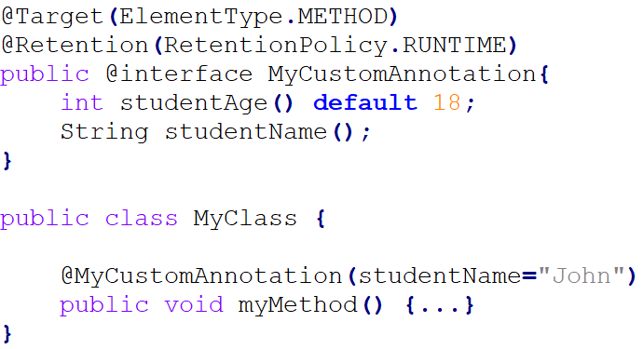
Annotations
Annotations are created by using @interface, followed by annotation name as shown in the below example.
An annotation can have elements as well. They look like methods. For example in the below code, we have two elements. We should not provide implementation for these elements.
All annotations extends java.lang.annotation.Annotation interface. Annotations cannot include any extends clause.

Slide 7
Annotations
@Target
ElementType.METHOD
ElementType.PACKAGE
ElementType.PARAMETER
ElementType.TYPE
ElementType.ANNOTATION_TYPE
ElementType.CONSTRUCTOR
ElementType.LOCAL_VARIABLE
ElementType.FIELD
@Retention
RetentionPolicy.RUNTIME: The annotation should be available at runtime, for inspection via java reflection.
RetentionPolicy.CLASS: The annotation would be in the .class file but it would not be available at runtime.
RetentionPolicy.SOURCE: The annotation would be available in the source code of the program, it would neither be in the .class file nor be available at the runtime.

Slide 8
Design Patterns

Slide 9
Design patterns
A design pattern is a well described solution to a common software problem.
Creational: provide solution to instantiate an object in the best possible way for specific situations.
Behavioural: provide solution for the better interaction between objects and how to provide loose coupling and flexibility to extend easily.
Structural: provide different ways to create a class structure, for example using inheritance and composition to create a large object from small objects.

Slide 10
Creational: Builder
Design patterns

Slide 11
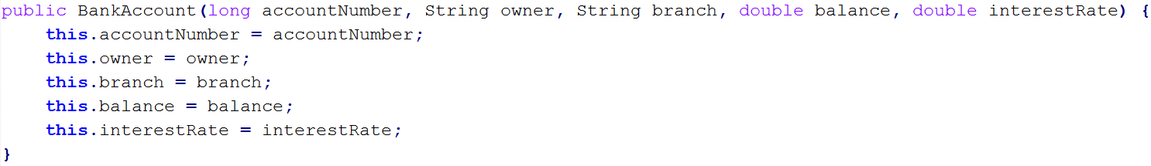
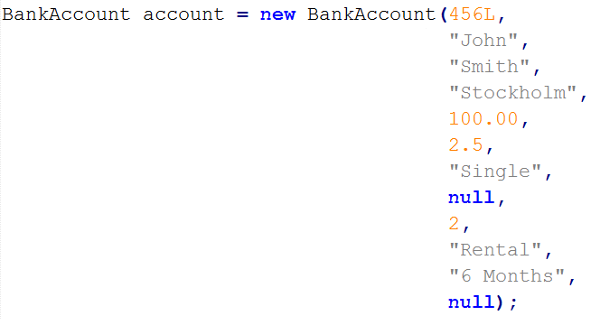
Builder pattern: the problem
Too many constructor arguments.
Incorrect object state.

Slide 12
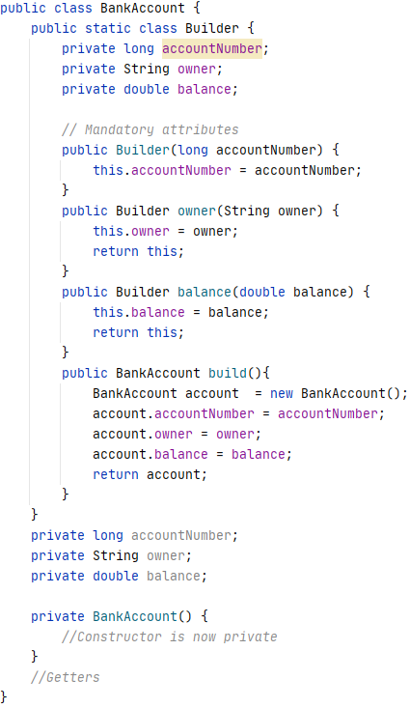
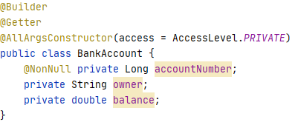

Slide 13
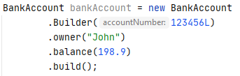
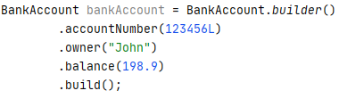
Builder pattern: the solution

Slide 14
Behavioural: Strategy
Design patterns

Slide 15
Strategy pattern: the problem
A Strategy Pattern says that "defines a family of functionality, encapsulate each one, and make them interchangeable".
Benefits:
It provides a substitute to subclassing.
It defines each behavior within its own class, eliminating the need for conditional statements.
It makes it easier to extend and incorporate new behavior without changing the application.
Usage
When the multiple classes differ only in their behaviours.
It is used when you need different variations of an algorithm.
Notes:
Reikia apsibrezti norimus funkcionalumus, juos enkapsuliuoti atskirose klasese, ir leisti juos pasiekti per ta pacia abstrakcija
Privalumai:
Pakeicia super ir sub class struktura
Jokiu if’u nuspresti del logikos, atskira logika atskiroje klaseje
Lengva prideti nauju funkcionalumu
Panaudojimas:
Kai kelios klases skiriasi tik behaviour, bet ju esme yra ta pati
Turbut geriausiai tinka

Slide 16
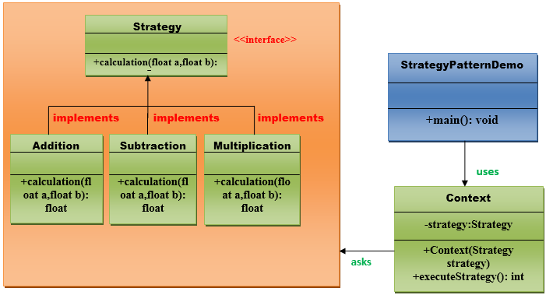
Strategy pattern: the solution

Slide 17
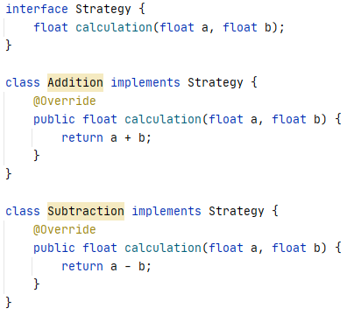
Strategy pattern: example (functionality encapsulation and abstraction)

Slide 18
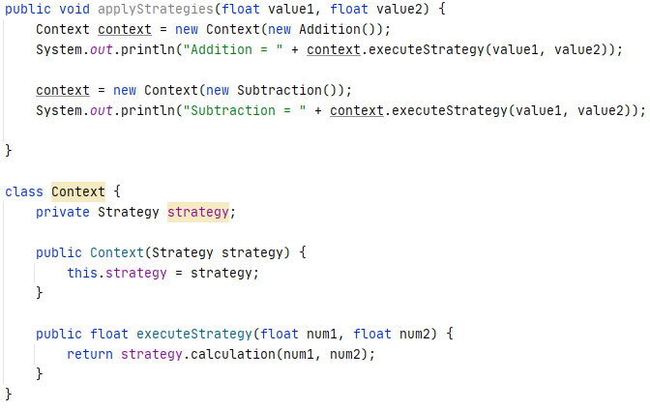
Strategy pattern: example (usage)

Slide 19
Structural: DAO/Repository
Design patterns

Slide 20
DAO/Repository pattern: the problem
Business and persistence layer separation
Changing persistence layer without affecting business logic
Notes:
Biznio logikos ir issaugojimo logikos atskyrimas
Galima keisti duomenu issaugojimo sluoksni, logika, Sistema, infrastukrura, visai neliecant biznio logikos

Slide 21
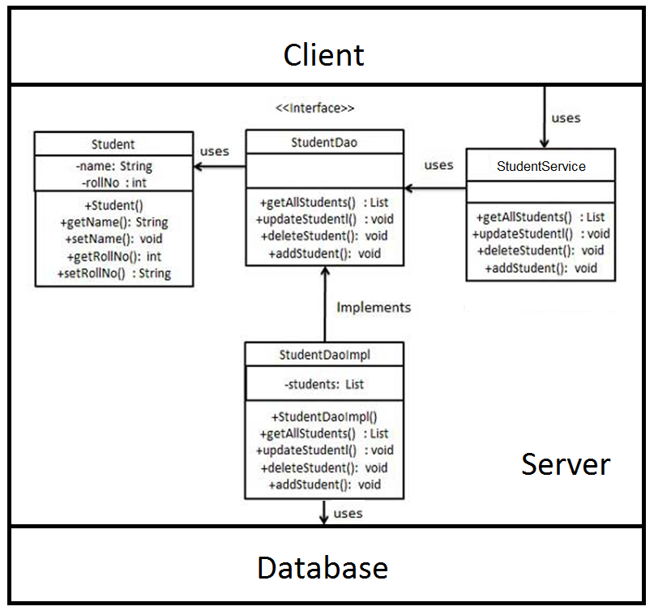
DAO/Repository pattern: the solution

Slide 22
What makes a language object-oriented?
OOP Concepts

Slide 23
OOP Concepts
Inheritance
Polymorphism
Encapsulation
Abstraction
Association
Aggregation
Composition
Delegation
Coupling
Cohesion

Slide 24
Association
OOP Concepts

Slide 25
Association
Relation between two separate classes which establishes through their Objects. Association can be one-to-one, one-to-many, many-to-one, many-to-many.
Types of association:
Aggregation
Composition

Slide 26
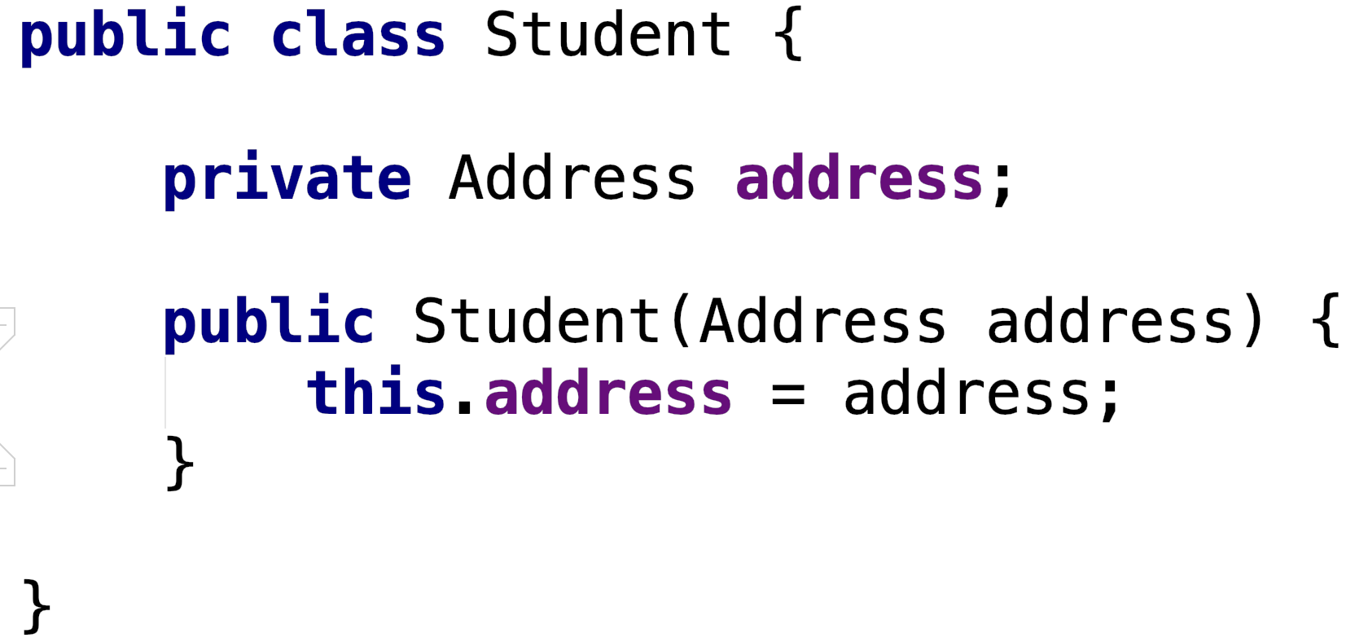
Association: Aggregation
Aggregation is a weak HAS-A association. An association is said to be aggregation if both Objects can exist independently and the relationship is one sided.
Student uses Address: Adrress exists independently from Student.

Slide 27
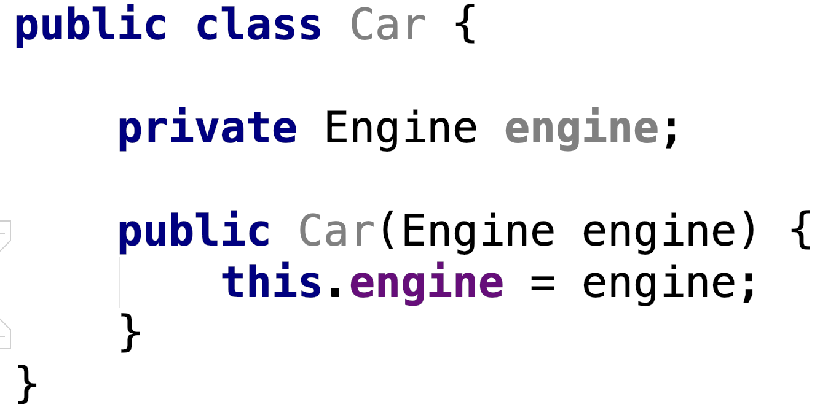
Association: Composition
Composition represents PART-OF relationship and is a restricted form of Aggregation in which two entities are highly dependent on each other.
Car owns Engine : Engine has no meaning or purpose in the system without Car.

Slide 28
Delegation
OOP Concepts

Slide 29
Delegation
Delegation can be an alternative to inheritance.
Delegation means that you use an object of another class as an instance variable, and forward messages to the instance.
Can be more suitable than inheritance because:
Doesn’t force you to accept all the methods of a super class - you can provide only the ones that make sense.
Inheritance might not be possible if the target class is declared final.
Multi inheritance might be needed.
Notes:
Privalumai lyginant su inheritance:
Galima pasirinkti kuriuos target klases metodus providinti
Kai target class yra final
Kai reikia kazko panasaus I multi-inheritnace

Slide 30
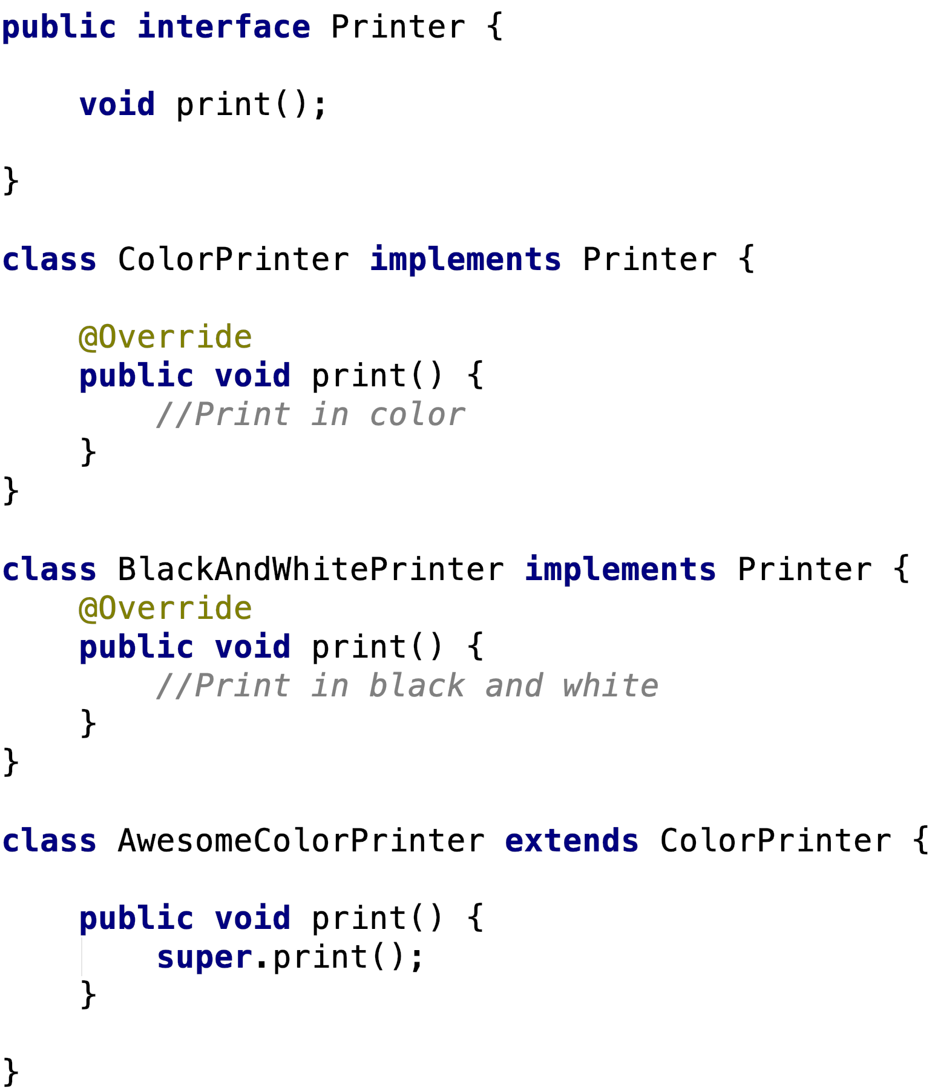
Inheritance

Slide 31
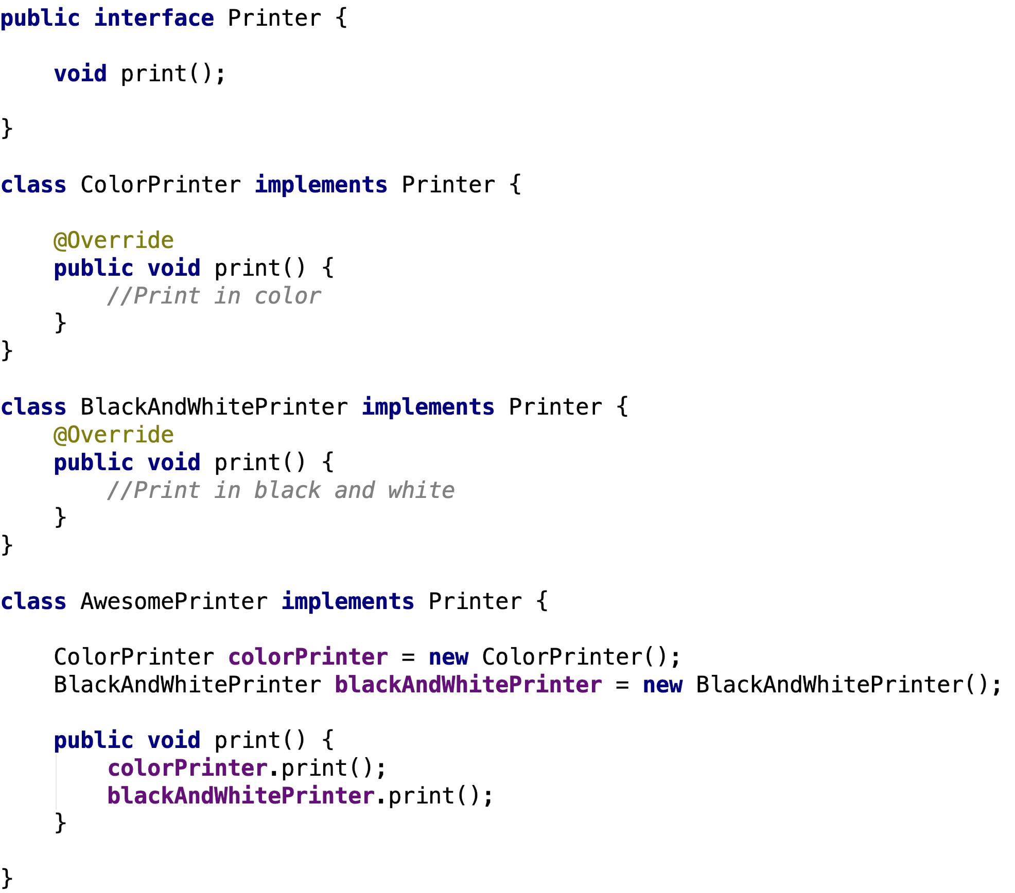
Delegation
Notes:
13:30 h

Slide 32
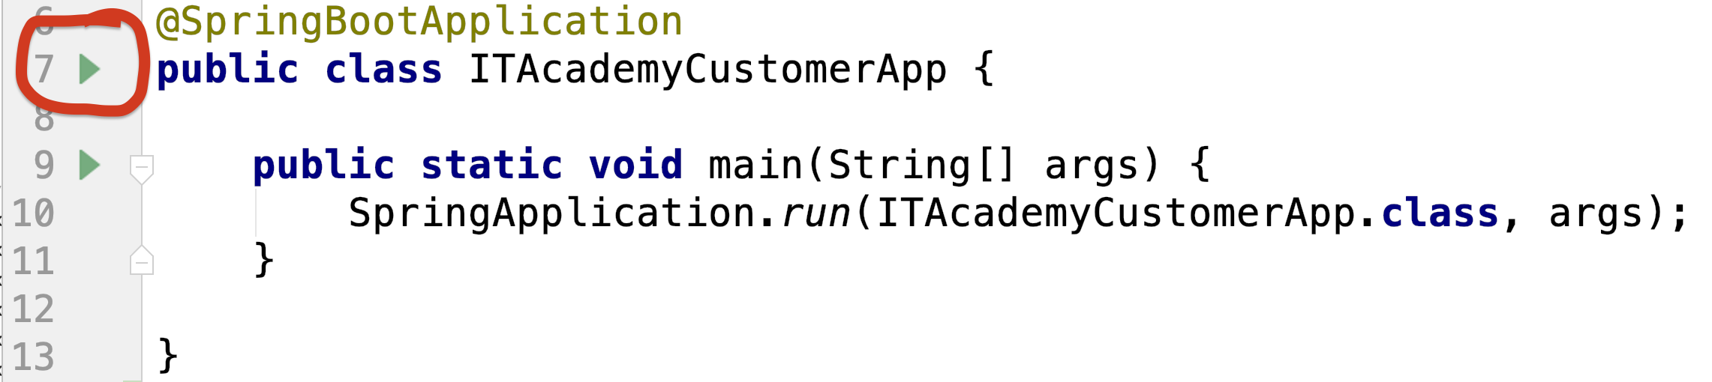
Starter code
https://github.com/mantelisb/academy-customer-app
Open in Intellij
Build
Run
Access application through: http://localhost:8080

Slide 33
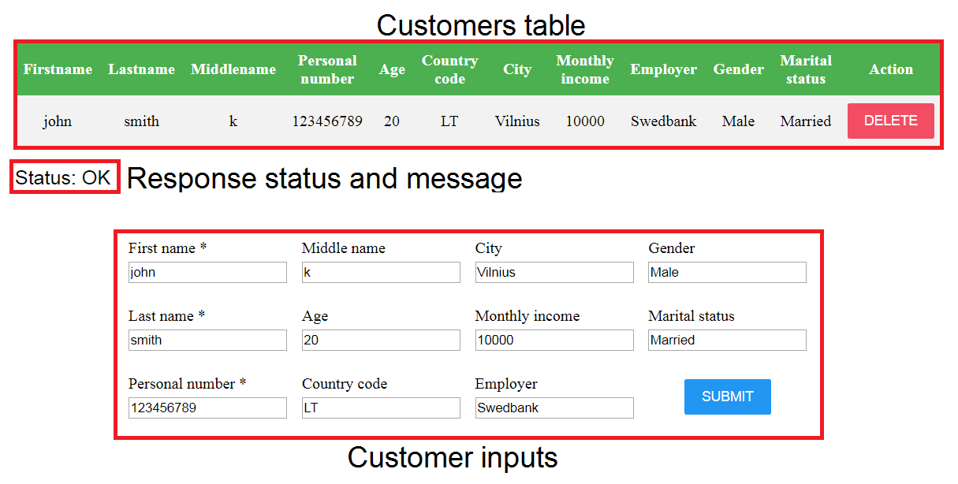
Customer application

Slide 34
1. Exercise: Make it work
At the moment the application is not finished and does nothing.
Requirements:
It should be possible to save customers, delete customers and fetch all customers.
Acceptance criteria:
CustomerRepository is converted to interface
MemoryCustomerRepository implements CustomerRepository
MainController uses CustomerRepository for insert/delete/fetch operations.
It's possible to insert, delete and display Customers.
Hint: For CustomerRepository instance inside MainController a simple initialization through constructor or spring’s dependency injection can be used.
Notes:
14 h

Slide 35
Coupling
OOP Concepts
Notes:
14:10 h

Slide 36
Coupling
Coupling refers to the degree of direct knowledge that one element has of another. In other words, how often do changes in class A force related changes in class B.
Tight coupling
Loose coupling
Notes:
Coupling parodo kiek daug viena klase zino apie kita, ir kaip daznai pakitimai vienoje klaseje isrovokoja pakitimus kitoe klaseje.

Slide 37
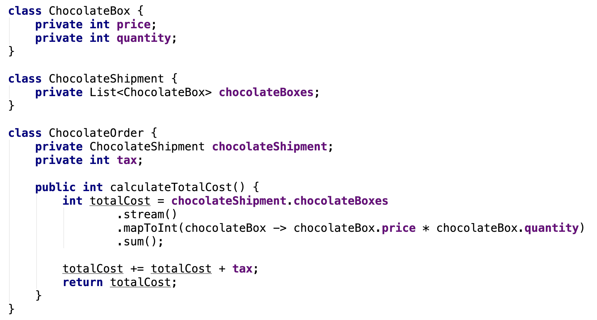
Tight coupling
Tight coupling means the two classes often change together. In other words, if A knows more than it should about the way in which B was implemented, then A and B are tightly coupled.
Notes:
Tight coupling – zino per daug, kai keiciasi viena klase keiciasi ir kita

Slide 38
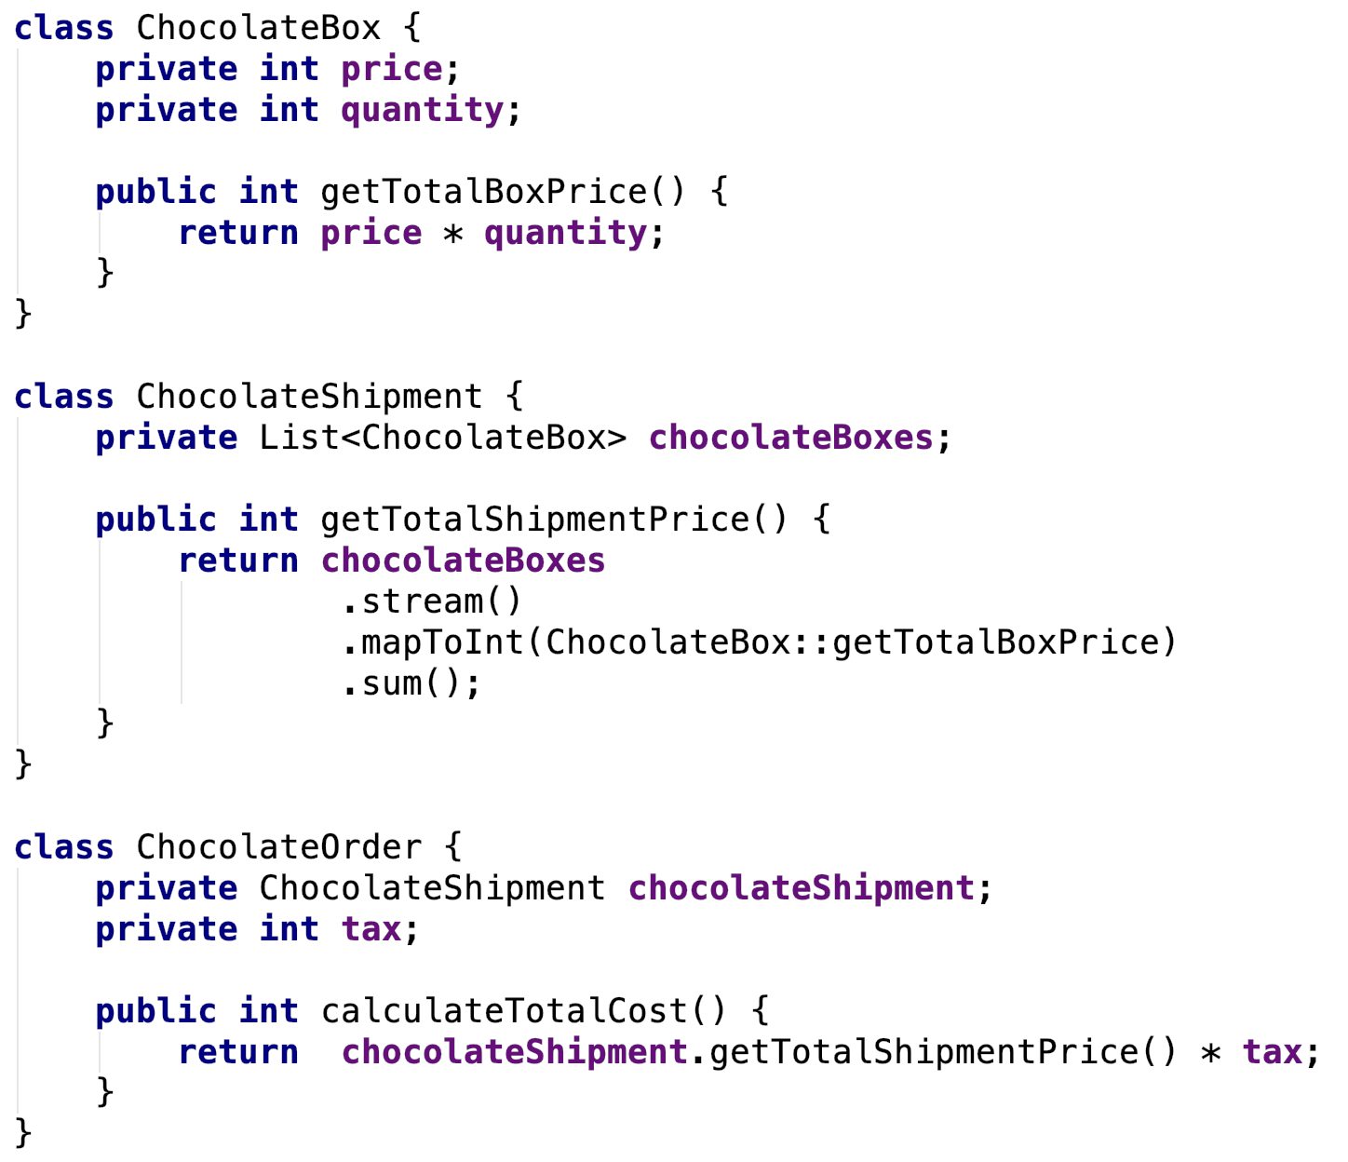
Loose coupling
Loose coupling means classes are mostly independent.
Notes:
Loose coupling – klases nepriklausomos

Slide 39
2. Exercise: Apply some formatting and decouple
Let’s apply some formatting for certain inputs. As we add more code it’s apparent that business logic must also be decoupled from other layers.
Requirements:
No matter how a user entered their first and last name they should always be saved with first letters capitalised. Personal number should have a dash after first 4 digits.
Acceptance criteria:
Data persistence is decoupled from MainController by creating CustomerService.
CustomerService uses MemoryCustomerRepository.
All formatting takes place in the CustomerService.
First name and last name of Customer are capitalised after saving (john smith must appear in the table as John Smith)
Personal number has a dash after first 4 digits after saving (entering 123456789 and saving must end up as 1234-56789 in the table)
Submitting should not fail trying to submit empty values or if personal number is less than 4 characters.
Notes:
14:30 h

Slide 40
Cohesion
OOP Concepts

Slide 41
Cohesion
Cohesion refers to the extent to which a class is defined to do a specific specialized task.
A class created with high cohesion is targeted towards a single specific purpose, rather than performing many different specific purposes.
Notes:
Cohesion – rodo kaip labai klase yra pritaikyta vienam tikslui

Slide 42
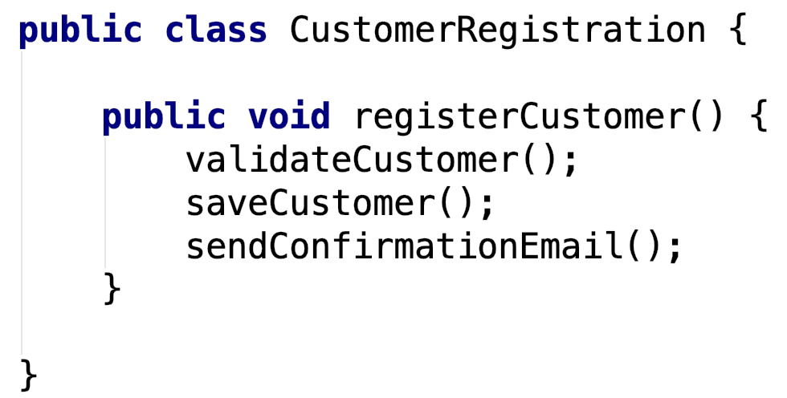
Cohesion: Low cohesion
Class is designed to do many different tasks rather than focusing on a single specialized task.

Slide 43
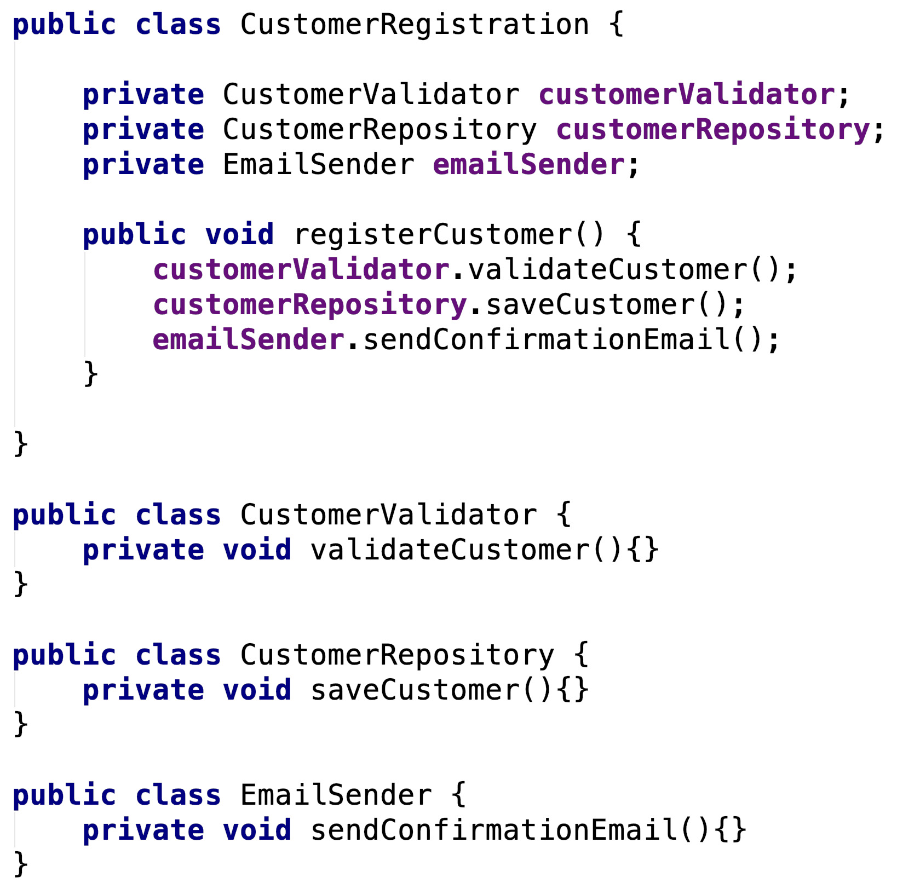
Cohesion: High cohesion
Class is design to do very specific, limited and focused tasks.

Slide 44
3. Exercise: Input validation
At the moment users can enter almost anything they want and it would get stored. The application needs validation to check for invalid input.
Requirements:
First name, last name and personal number are already marked as mandatory inputs in frontend. Validation for those 3 attributes and age has to be implemented.
Acceptance criteria:
Validation for mandatory attributes: first name, last name and personal number is implemented.
Validator class is implemented to validate the input before formatting/storing.
Validator throws existing MandatoryValueMissingException if any of the mandatory inputs are missing.
An appropriate validation messages are passed to MandatoryValueMissingException when throwing them.
Validator class is used inside CustomerService.
HTTP error code 422 and appropriate message is seen under table when trying to submit invalid inputs.
Submitting spaces as input should also fail with the same exception and message.
Notes:
14:50 h

Slide 45
3.1 Exercise: Input validation
Requirements:
Age is now also a mandatory input, so validation for age restriction has to be implemented. Also only LT, LV, EE and SE are accepted as country code values if one was provided.
Acceptance criteria:
New type of validation Exception class CustomerNotAdultException created for age validation. HTTP code should be the same as for MandatoryValueMissingException.
Validation for age is implemented: age is mandatory and cannot submit customer with age less than 18.
Enum class for country codes is created containing following values: LT, LV, EE, SE
New type of validation Exception - InvalidCountryCodeException is created for country code validation. HTTP code should be the same as for MandatoryValueMissingException.
Validation exception is thrown when trying to submit customer with age under 18.
Validation exception is thrown when trying to submit customer with country code other than LT, LV, EE or SE. Country code validation id not triggered if no country code was provided at all.
Hint: See the way MandatoryValueMissingException is constructed. A default message can be passed to @ResponseStatus annotation by attribute: reason = “Message text”.
Notes:
15:05 h

Slide 46
Immutability
Notes:
15:15 h

Slide 47
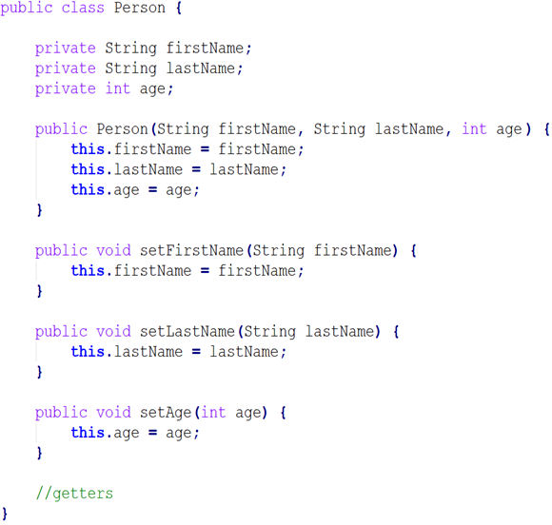
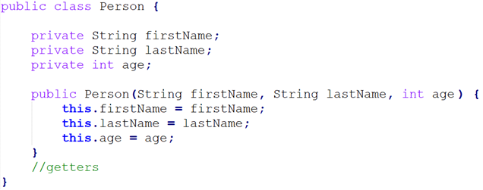
An immutable object is an object whose internal state remains constant after it has been entirely created.

Slide 48
Immutability: final keyword
By using the final keyword when declaring a variable, the Java compiler won’t let us change the value of that variable. Instead, it will report a compile-time error.
Note that final only forbids us from changing the reference the variable holds, it doesn’t protect us from changing the internal state of the object it refers to by using its public API.
java.util.Collections provides a number of convenience methods for converting a Collection to an UnmodifiableCollection: Collections.unmodifiableCollection, Collections.unmodifiableList, etc.

Slide 49
Immutability: advantages
Immutable objects are thread-safe so you will not have any synchronisation issues.
Immutable objects are good Map keys and Set elements, since these typically do not change once created.
Immutability makes it easier to write, use and reason about the code (since there is no hidden side effects)
References to immutable objects can be cached as they are not going to change.
Easier to debug.
Notes:
thread safe todel nebus sync issues
Map keys ir set elementai neturetu kisti
Palengvina kodo naudojima ir veikimo supratima, nes nera pasleptu salutiniu efektu
Galima cashuoti, nes state nesikeis
Lengviau debuginti

Slide 50
Immutability: disadvantages
Creating an immutable class seems at first to provide an elegant solution. However, whenever you do need a modified object of that new type you must suffer the overhead of a new object creation, as well as potentially causing more frequent garbage collections.
Notes:
Kai reikia kiek pakeisto objekto, turi ji is naujo perkurti

Slide 51
4. Exercise: Did you just mutate that data?
In software development data mutation (mutability) is an unwanted side effect of programming which should be avoided as much as possible.
Requirements:
The mutated Customer properties (first name, last name and personal number) should not be set onto the same Customer object coming from MainController. To make things right, a new Customer object with all the same properties from old Customer, plus new first name, last name and personal number should be created. To make things even better - builder pattern should be implemented.
Acceptance criteria:
Customer object is not mutated before passing it to CustomerRepository.
New instance of Customer is created with all original Customer's data plus formatted ones.
To create Customer object a builder pattern is used.
Hint: Three attributes - first name, last name and personal number are mandatory.
Note: Make an exception and leave setter for customer id, since it's used to determine which of the customers has to be deleted, but don't include it in the builder.
Notes:
15:35 h

Slide 52
Generics

Slide 53
Generics
Java Generic methods and generic classes enable a way to specify a set of related methods with a single method declaration, or a set of related types with a single class declaration.
Generic were designed to extend Java's type system to allow "a type or method to operate on objects of various types while providing compile-time type safety".
You can write a single generic method declaration that can be called with arguments of different types. Based on the types of the arguments passed to the generic method, the compiler handles each method call appropriately.
All generic method declarations have a type parameter section delimited by angle brackets (< and >) that precedes the method's return type ( < E > in the next example).
Each type parameter section contains one or more type parameters separated by commas. A type parameter, also known as a type variable, is an identifier that specifies a generic type name.
The type parameters can be used to declare the return type and act as placeholders for the types of the arguments passed to the generic method, which are known as actual type arguments.
A generic method's body is declared like that of any other method. Note that type parameters can represent only reference types, not primitive types (like int, double and char).
Notes:
Generic gali buti tiek visa klase tiek single metodas.
Generic buvo sukurti kad praplesti java type’us, ir leisti metodui ar klasei dirbti su skirtingo tipo objektais islaikant compile-time type safety.
Generic metodams reikia apibrezti naudojamus type name pries return type deimanciukuose
Galima apibrezti ne viena type name, atskyrus juos kableliais.
Apibrezus type names, juos po to gali naudoti ar kaip input parameters, ar kaip return value, ar paciame metodo viduje nurodant objekto tipa.
Genericai negali apibrezti primityvu

Slide 54
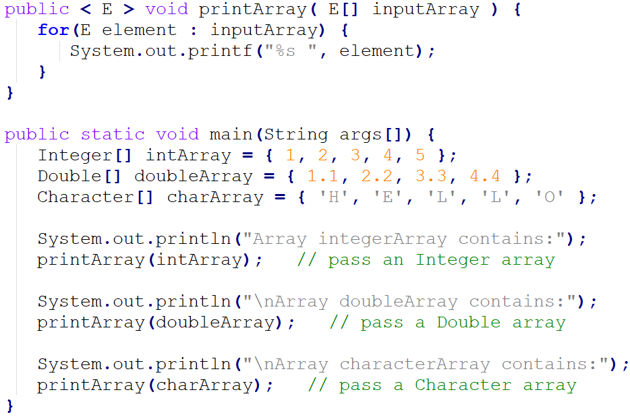
Generics: methods

Slide 55
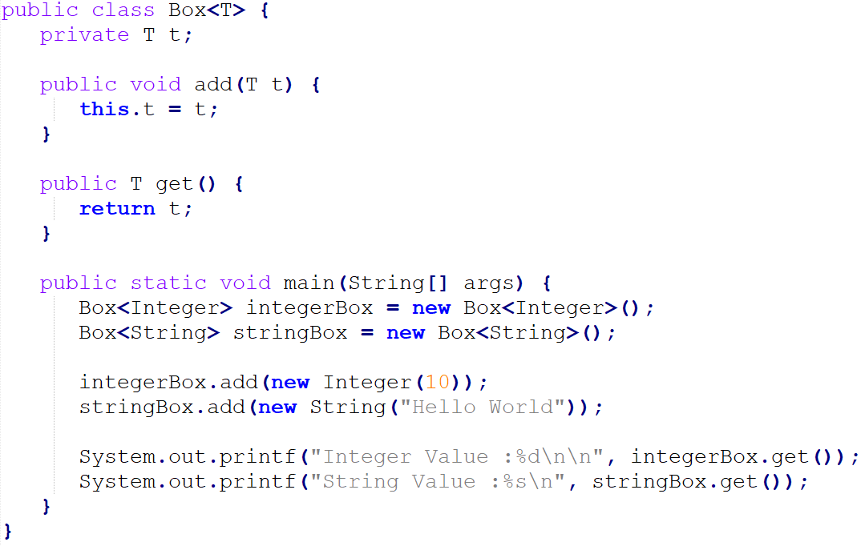
Generics: classes

Slide 56
Generics type name convention
By convention, type parameter names are named as single, uppercase letters so that a type parameter can be distinguished easily with an ordinary class or interface name. Following is the list of commonly used type parameter names −
E − Element, and is mainly used by Java Collections framework.
K − Key, and is mainly used to represent parameter type of key of a map.
V − Value, and is mainly used to represent parameter type of value of a map.
N − Number, and is mainly used to represent numbers.
T − Type, and is mainly used to represent first generic type parameter.
S − Type, and is mainly used to represent second generic type parameter.
U − Type, and is mainly used to represent third generic type parameter.
V − Type, and is mainly used to represent fourth generic type parameter.
Notes:
Dazniausiai Generic type name, yra viena, didzioji raide, kad butu lengviau skaityti ir suprasti koda.

Slide 57
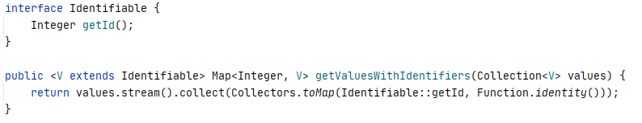
Generics: bound types
Enables programmers to restrict what type of objects are accepted.
To declare a bounded type parameter, list the type parameter's name, followed by the extends keyword, followed by its upper bound.

Slide 58
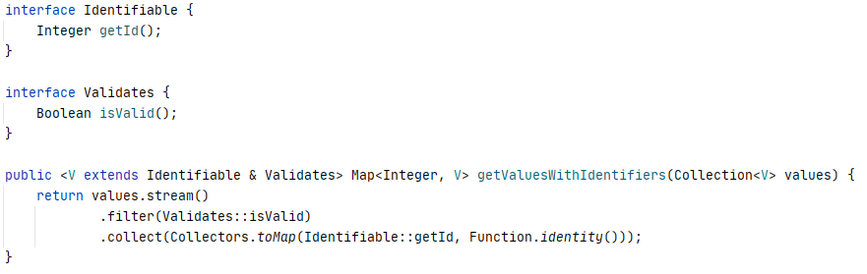
Generics: multiple bound types
Enables programmers to restrict what super types object should have .
To declare a multiple bounded type parameter, separate them by &.

Slide 59
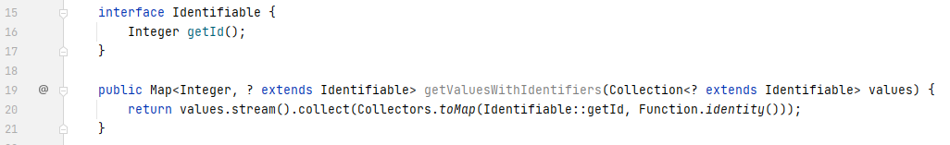
Wildcard
Wildcards are represented by the question mark ?, and it refers to unknown type.

Slide 60
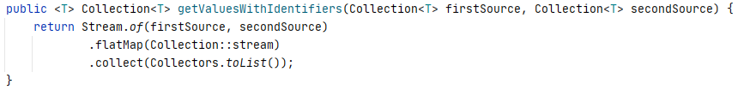
Generics vs Wildcard (1)
If you want to enforce some relationship on the different types of method arguments, you can't do that with wildcards, you have to use type parameters.
Type parameters support multiple bounds, wildcards don’t.

Slide 61
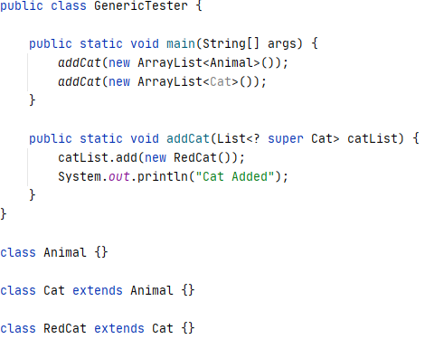
Generics vs Wildcard (2)
Wildcards support both upper and lower bounds, type parameters just support upper bounds.

Slide 62
5 Exercise: Reusable validators
Requirements:
Let’s imagine customer application is way bigger than it is and we need to validate a bunch of similar attributes that we validate for Customer object. Let’s create reusable validators just for those purposes.
Acceptance criteria:
Abstract class Validator<T> accepting generic T is created.
Abstract Validator has a single method: public abstract void validate(T attribute).
3 Separate validators created extending the abstract Validator class: MandatoryCustomerValuesValidator, CustomerAdultValidator, CountryCodeValidator.
Single Exception: ValidationException created instead of previous 3.
ValidationException is constructed with String message.
CustomerValidator methods replaced with the newly created Validator classes.
New validators are created and called inside CustomerValidator.
ValidationException along with message is thrown when validation fails.
All validation logic stays the same.
Notes:
16:05 h

Slide 63
Functional Interfaces
Notes:
16:15 h

Slide 64
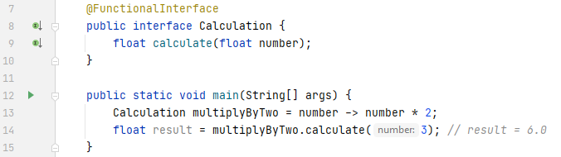
Simple functional interface example

Slide 65
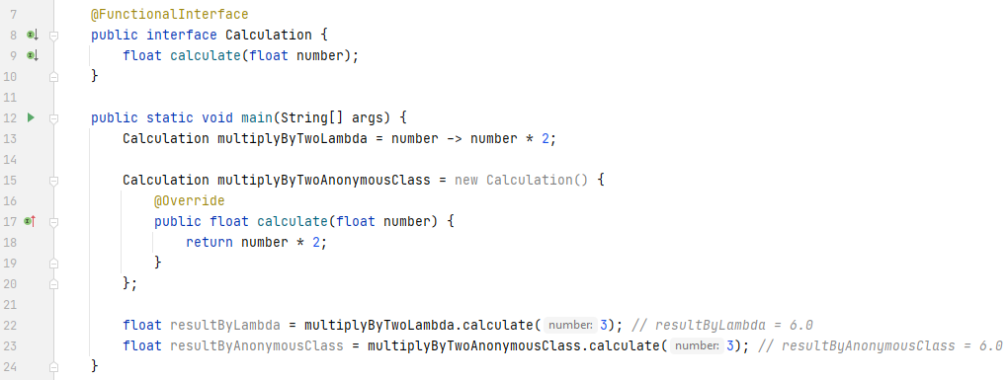
Functional interface vs anonymous class

Slide 66
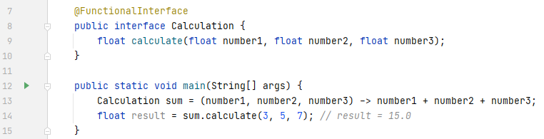
Multiple params functional interface example

Slide 67
Functional interfaces example comparison

Slide 68
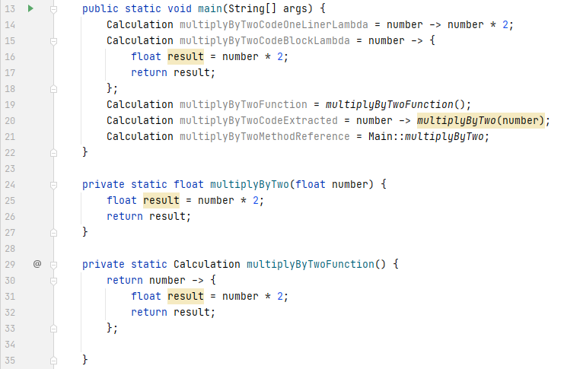
Functional interface more usage examples

Slide 69
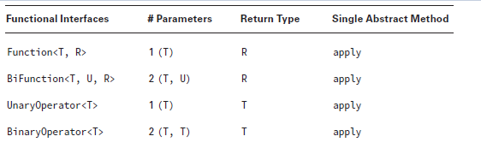
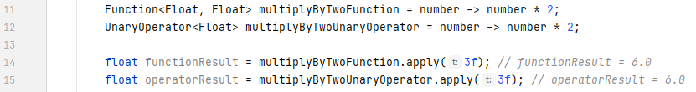
Function and operator

Slide 70
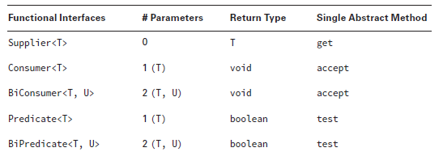
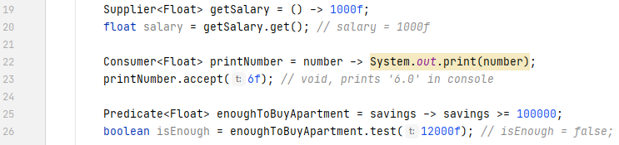
Supplier, consumer, predicate

Slide 71
Optional

Slide 72
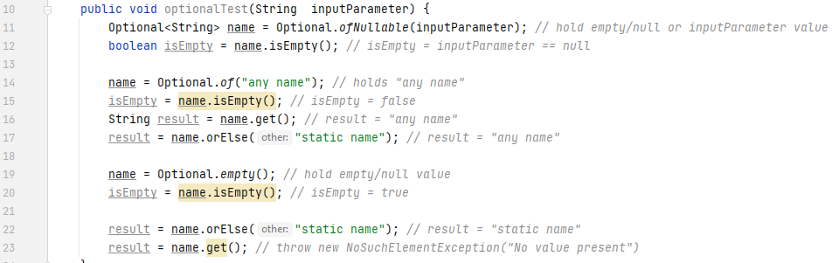
Optional

Slide 73
Fancy feature

Slide 74
Extra
Play with functions and consumer, chaining : apply several functions
Play with some Optional methods:
map : if value exists, convert to another value
ifPresent : if value exists, do something with it
orElse : if value is empty, return default value
orElseThrow : if value empty, throw exception
Notes:
16:05 h

